Slide 1

Notes:
Jason McClaren — help you can check before you buy

Slide 2
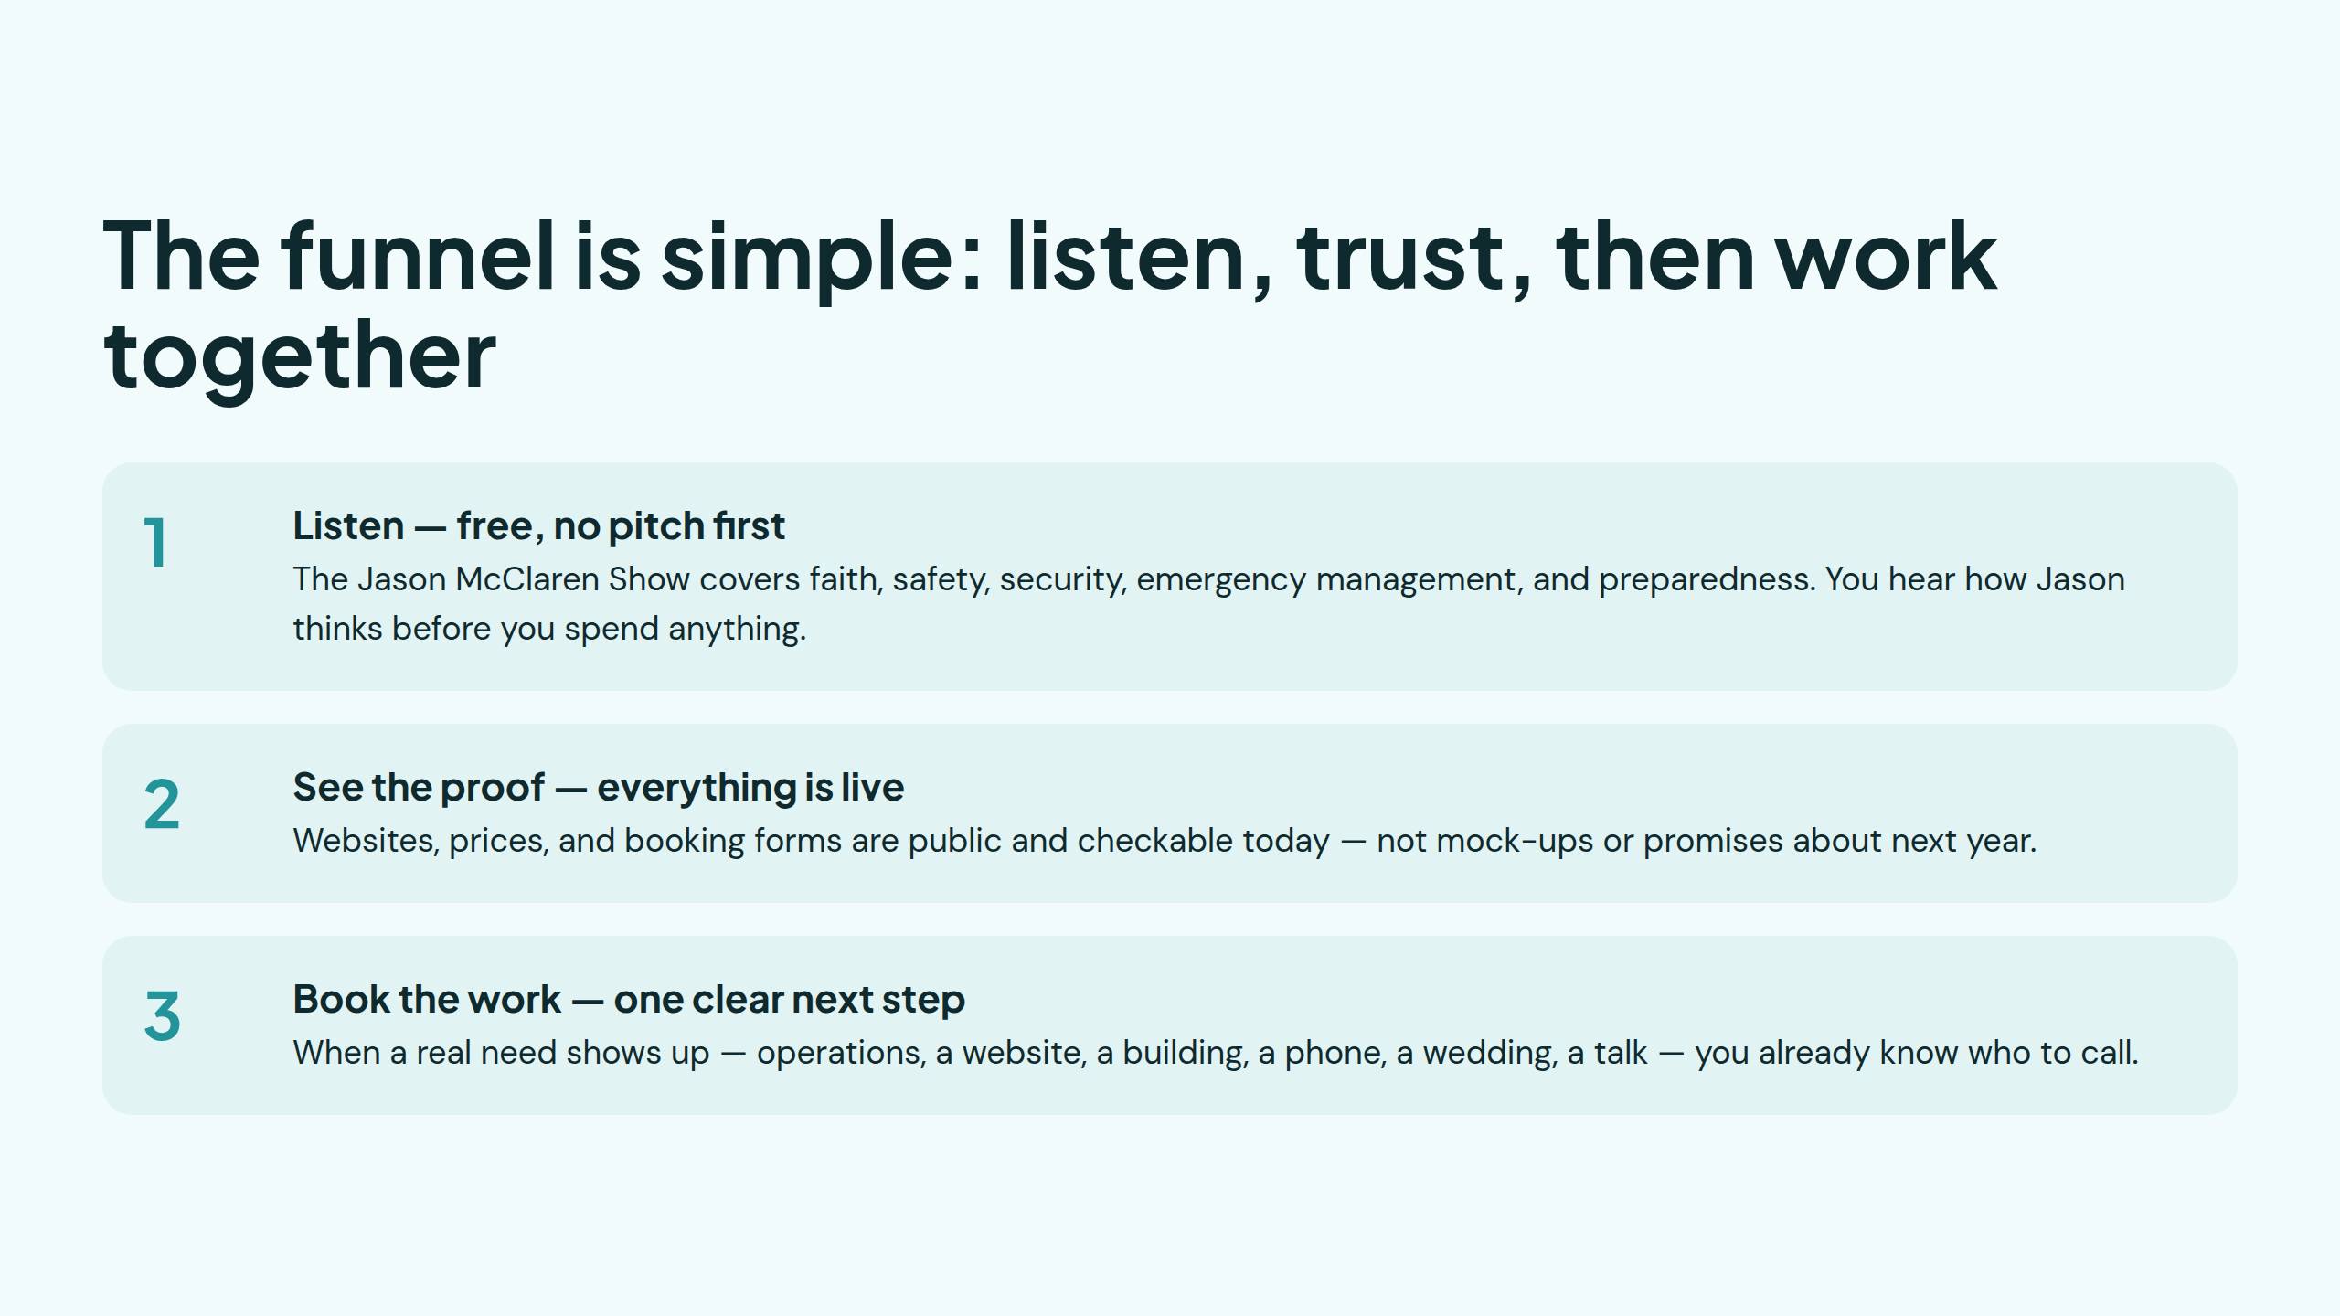
Notes:
The funnel is simple: listen, trust, then work together

Slide 3
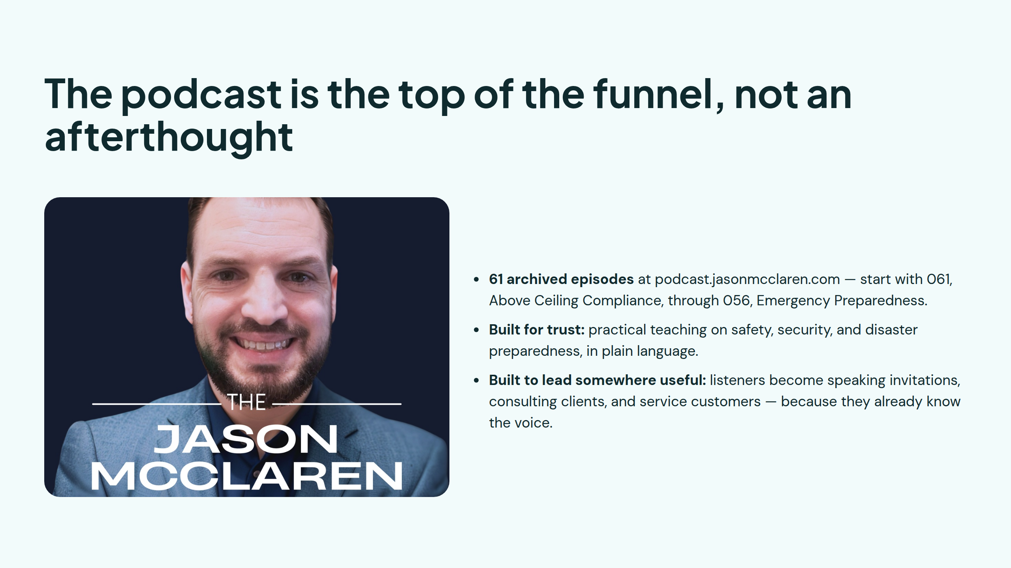
Notes:
The podcast is the top of the funnel, not an afterthought

Slide 4
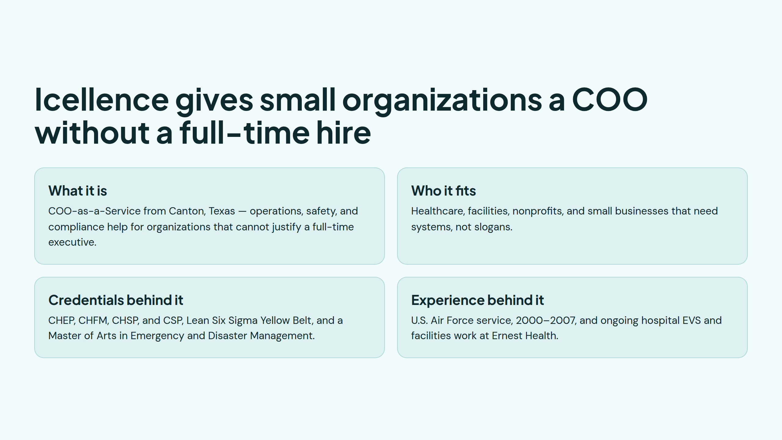
Notes:
Icellence gives small organizations a COO without a full-time hire

Slide 5
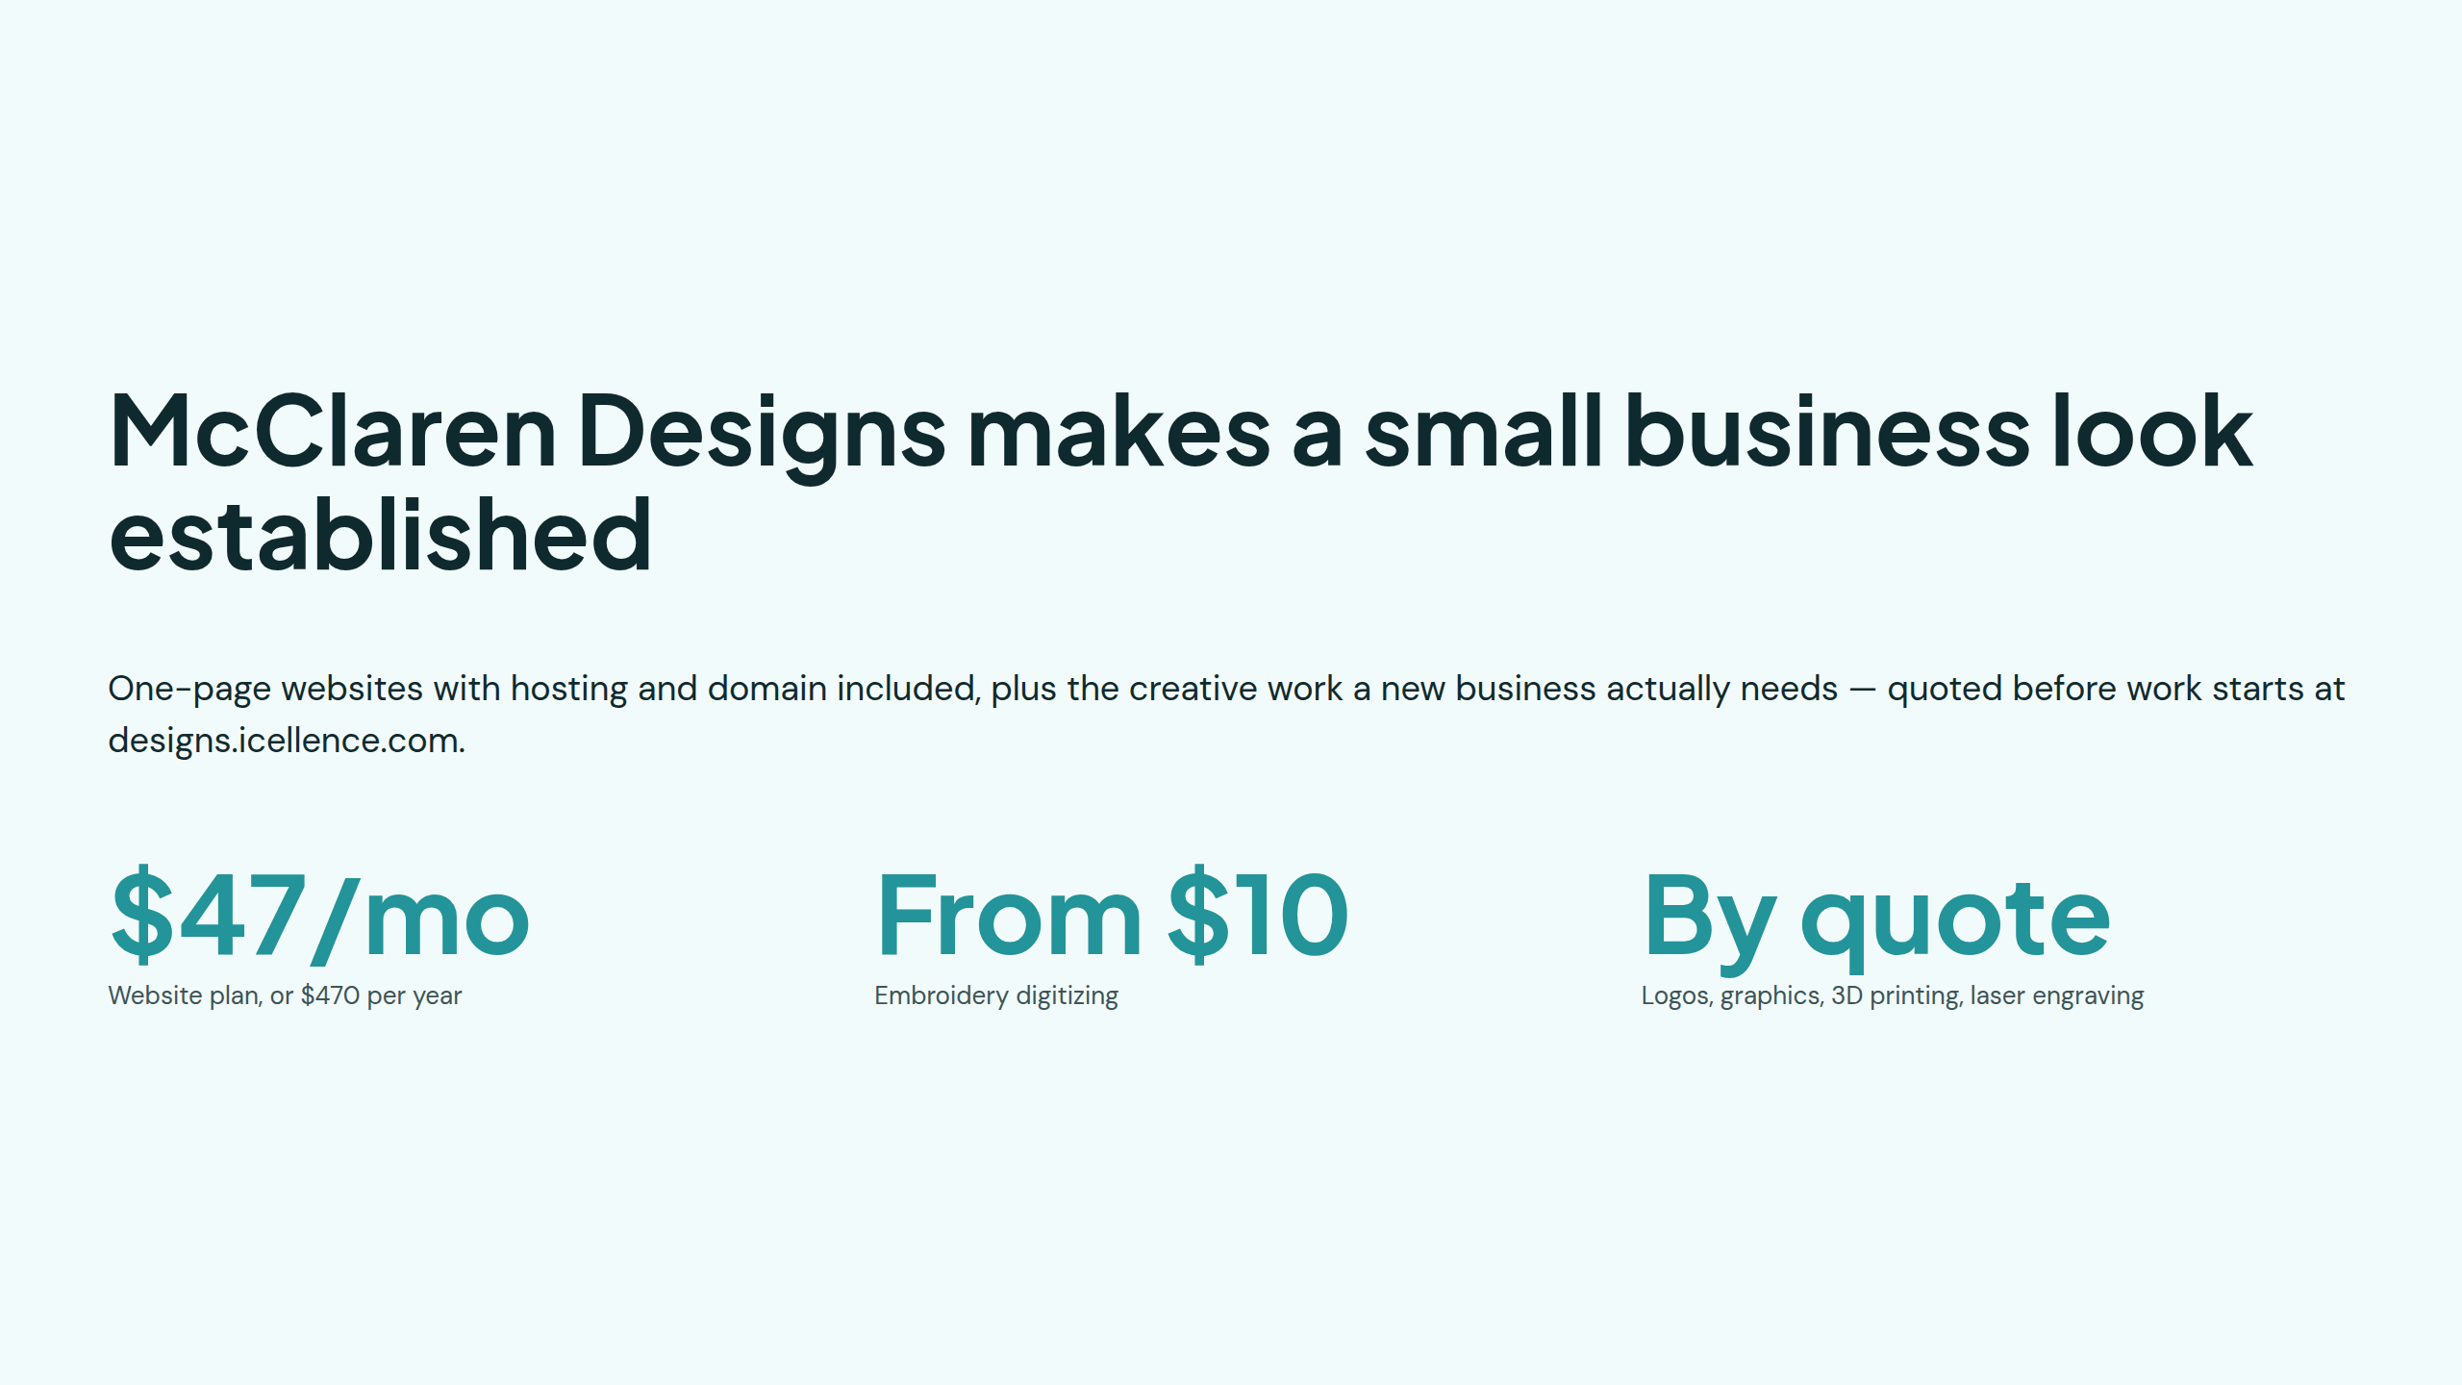
Notes:
McClaren Designs makes a small business look established

Slide 6
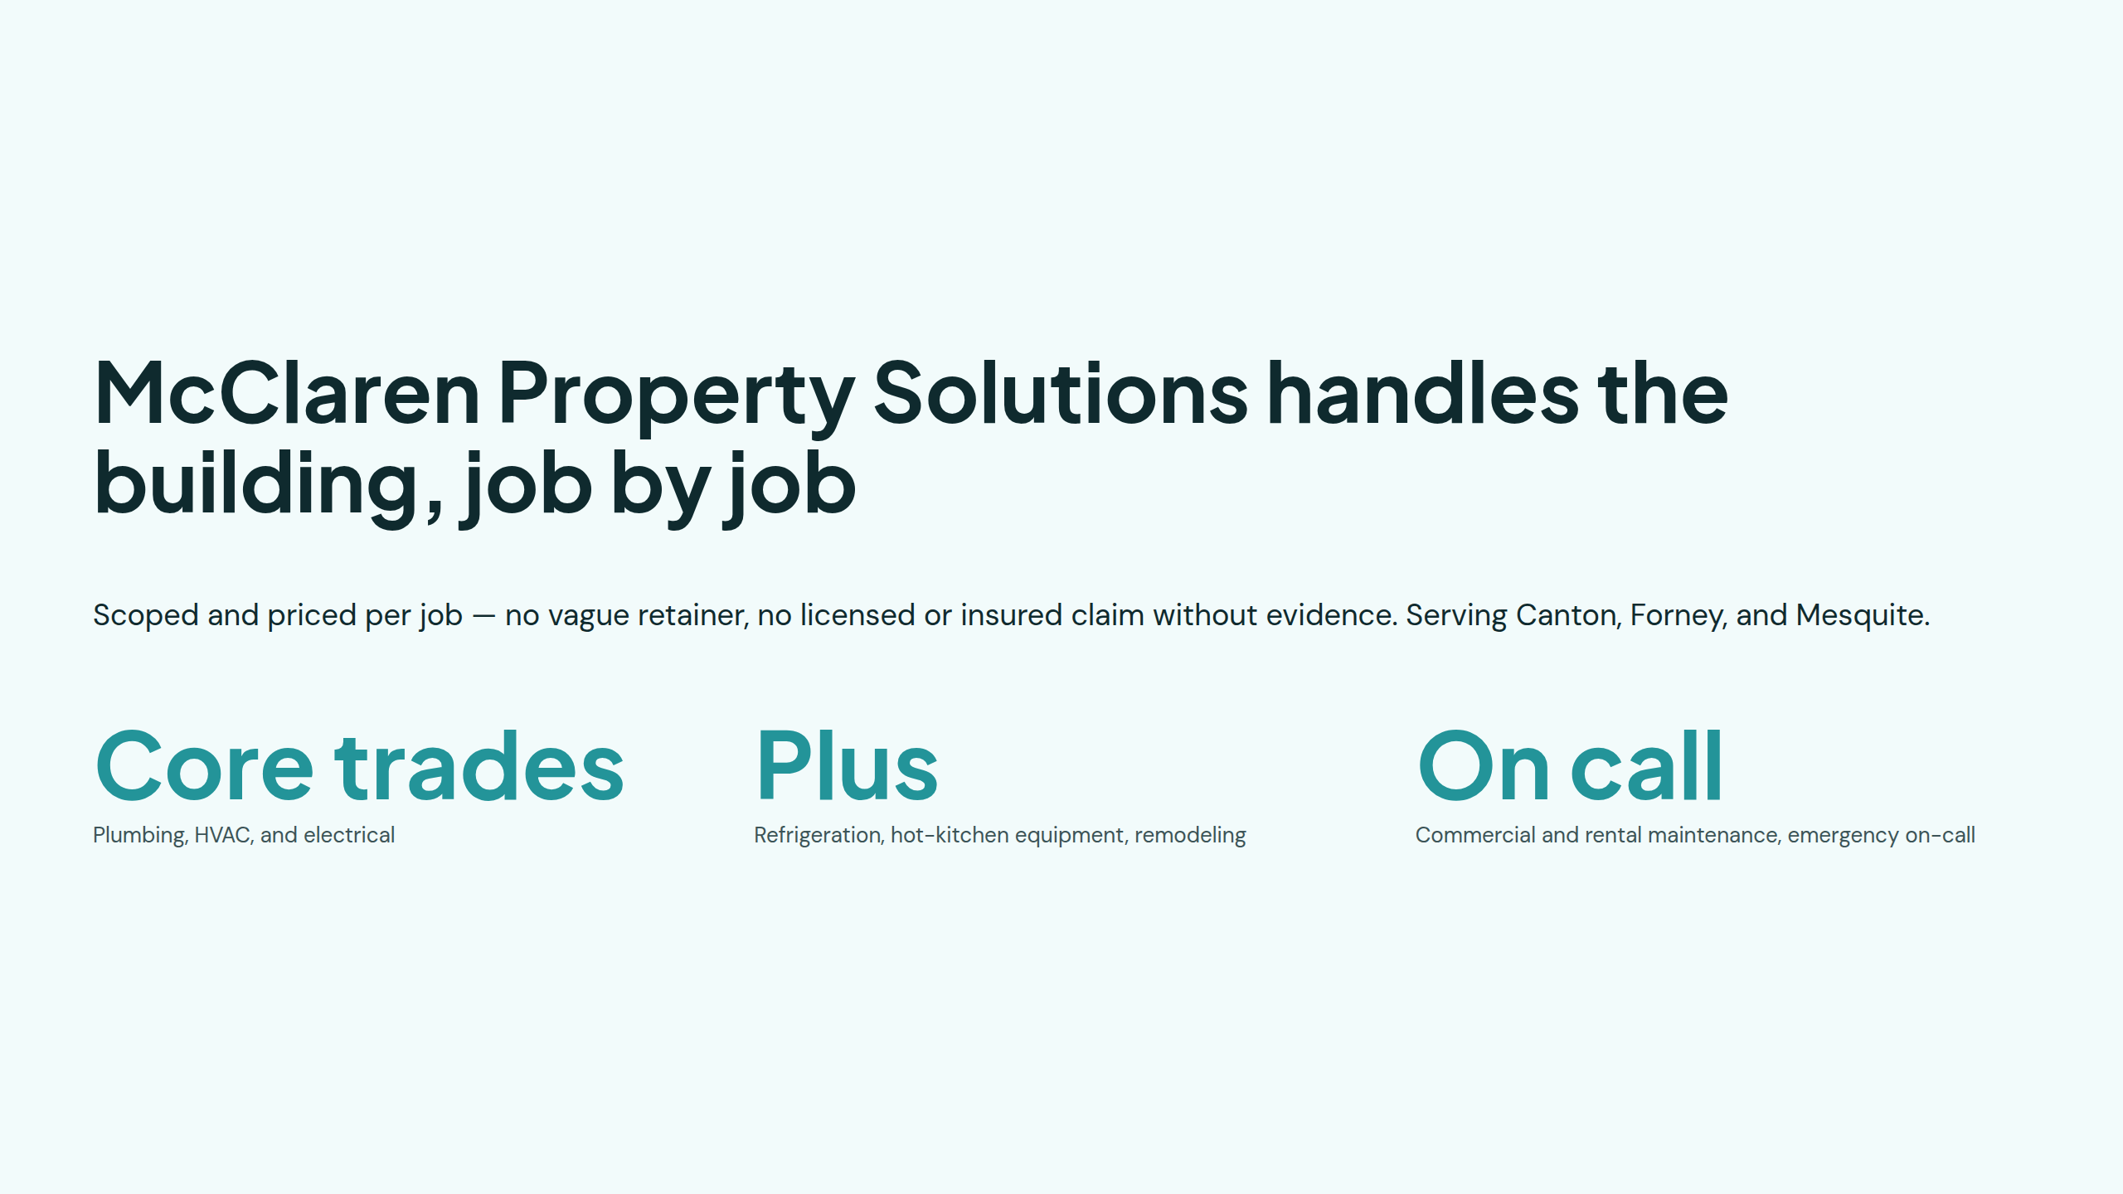
Notes:
McClaren Property Solutions handles the building, job by job

Slide 7
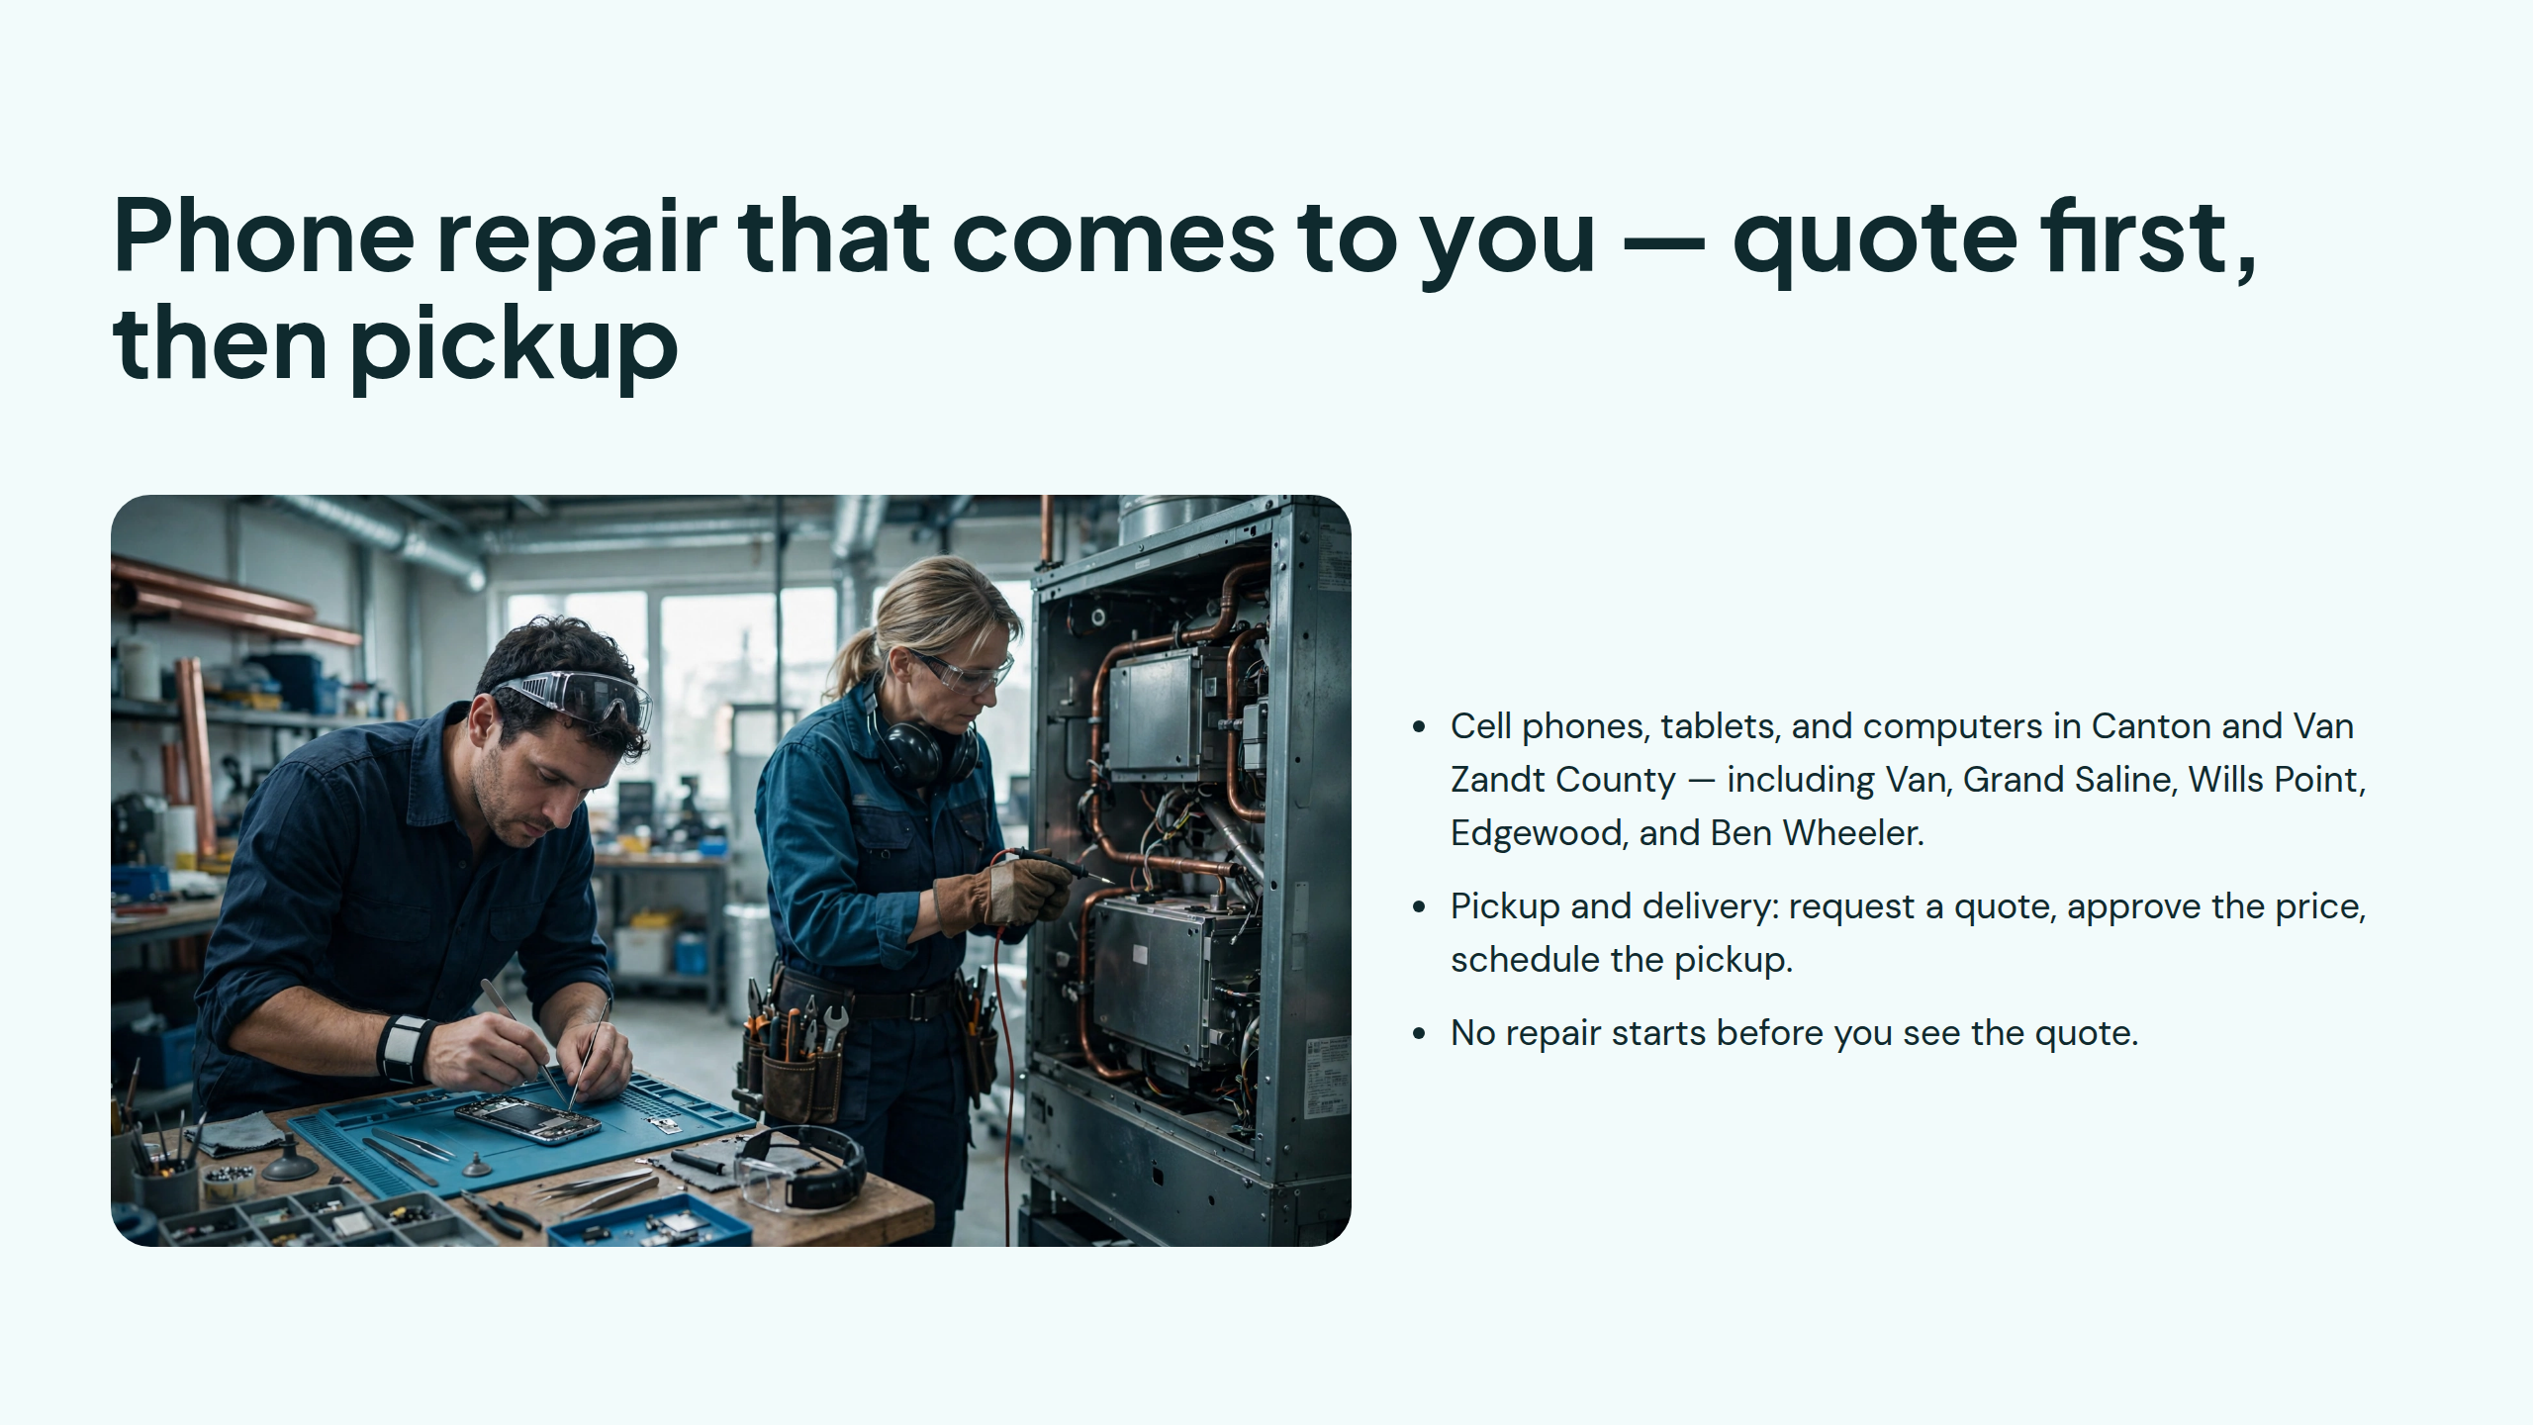
Notes:
Phone repair that comes to you — quote first, then pickup

Slide 8
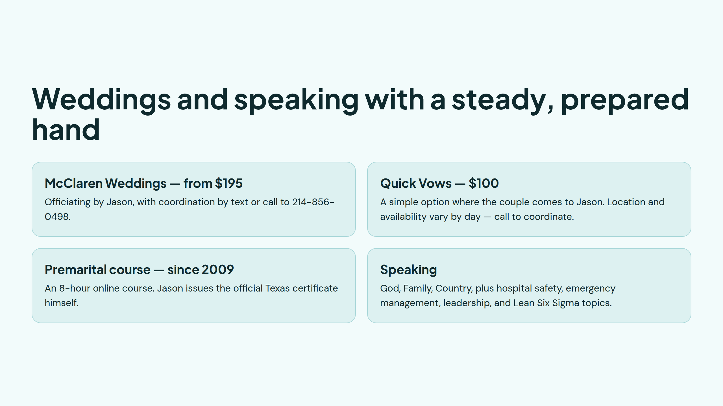
Notes:
Weddings and speaking with a steady, prepared hand

Slide 9
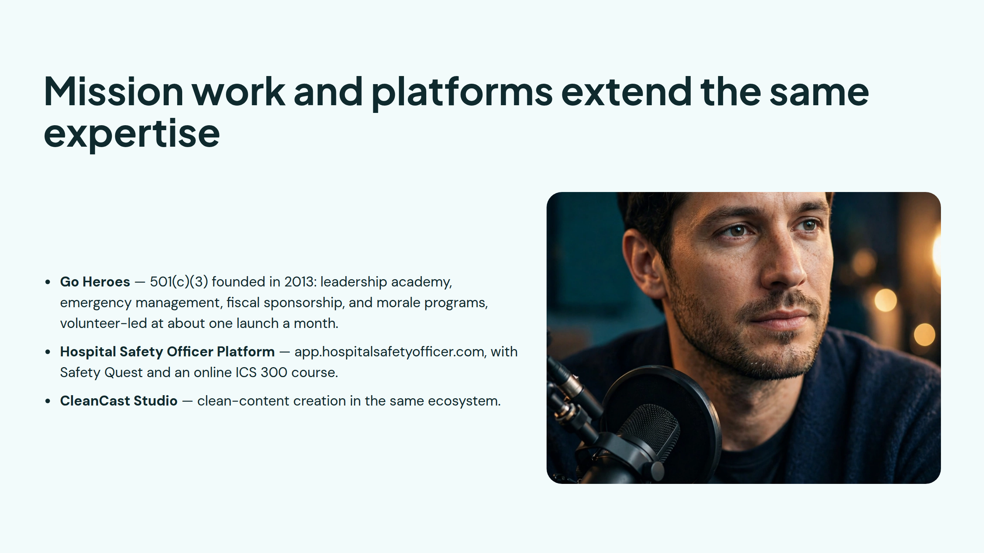
Notes:
Mission work and platforms extend the same expertise

Slide 10
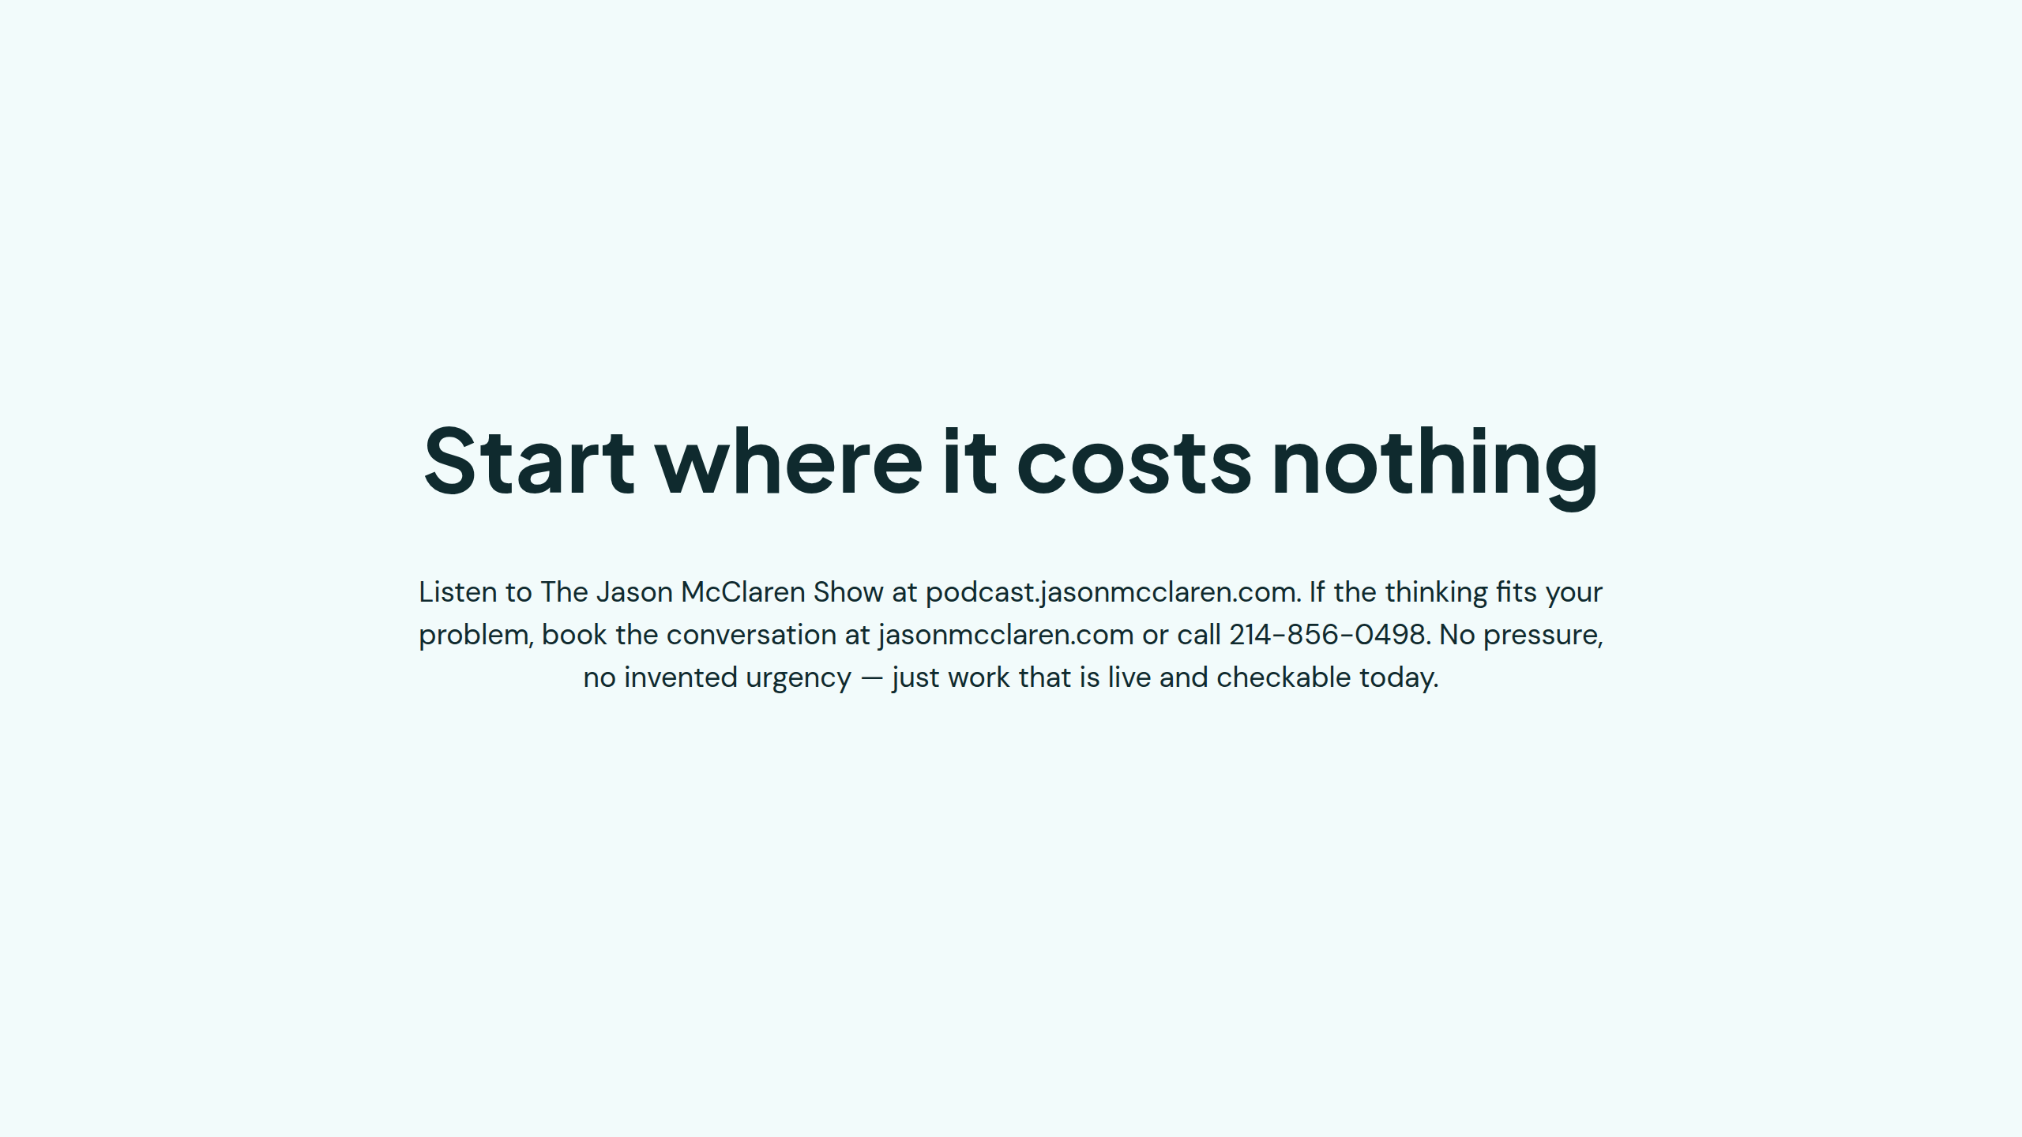
Notes:
Start where it costs nothing

